Slide 1
Erda Acres Water Company
2018 Annual Meeting
Annual Letter
Major Agenda Items:
Water system status, connections, usage and 2019 initiatives
2018-2019 budget
Proposed water rate increase for 2018-2019
Water company acquisition offer
Shareholder Q&A
Board member election
Shareholder Adjourn
November 2018 board meeting.
Recommendations:
The Board is recommending an increase in the water rates for 2018-2019.
  EAWC has not increased rates since the completion of the new system in 2009. The stability of our water rates is due to the increased number of connections. However, the growth in Erda has slowed due to requirements imposed by Tooele County to have new developments connected to sewer.
  Current monthly rate: $40.00 monthly base fee + $0.75 for each 1,000 gallons of water used up to 70,000 gallons + $1.25 for each 1,000 gallons of water used over 70,000.
EAWC Overview:
Currently, EAWC finances are steady with adequate reserves. The water system, which includes a storage tank, two wells, two water pumps, a booster station, a generator and a distribution system are all functioning properly.
EAWC infrastructure is sound, however, repairs and upgrades to the system are consistently required to address meter reading issues, leaks, and operation of fire hydrants.
Backflow prevention. Remember water can flow two directions in a hose. If ther water pressure becomes lower than normal water can flow backwards. Some helpful hints. Ensure water leaving a hose runs through an air space gap of at least 2 inches before it enters into a container. Another tip is to make sure there is a hose-bibb vacuum breaker attached to all outdoor spigots.
The proposed budget for 2018-2019, the minutes from last year’s Shareholder Meeting, the voting proxy form and this year’s meeting agenda are posted at www.erdawater.com. Please come, participate, and vote on the decisions that will shape our water company’s future.

Slide 2
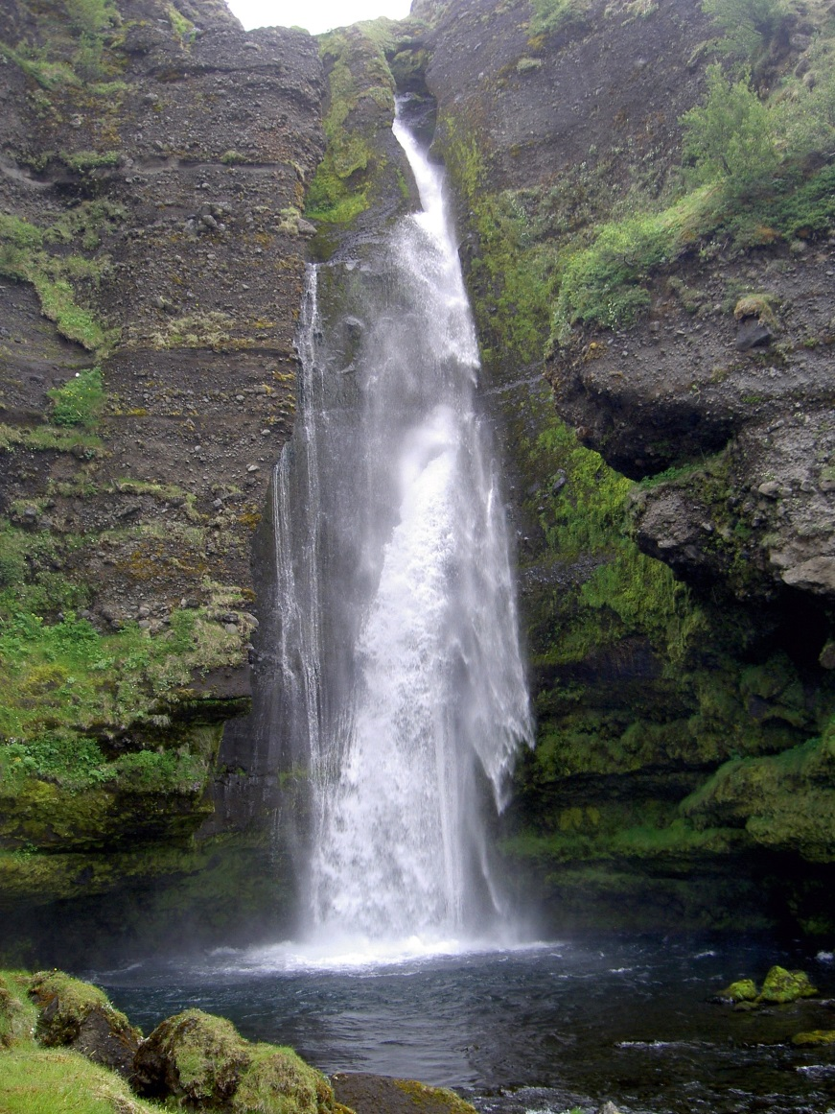
Erda Acres Water Company
2018 Annual Meeting
Fiscal Year 2018 Changes
Hired new attorney Jon Schutz from the law firm Mabey Wright & James PLLC.
Previous attorney Brent Rose also represented Stanbury Park Improvement District and Tooele City. (Clyde Snow Attorneys at Law).
Hired attorney James Krause from Michael Best Friedrich LLP (specializes in the buying and selling of companies)
Changed Engineer of record to Epic Engineering.

Slide 3

Erda Acres Water Company
2018 Annual Meeting
2014 & 2015 Water Usage

Slide 4

Erda Acres Water Company
2018 Annual Meeting
2016 & 2017 Water Usage

Slide 5

Erda Acres Water Company
2018 Annual Meeting
2018 Water Usage

Slide 6

Erda Acres Water Company
2018 Annual Meeting
Erda Acres Annual Scholarship
$500
2018 winner - Whitney Clark
2017 winner - Ashley Beazer

Slide 7

Erda Acres Water Company
2018 Annual Meeting
2018 – 2019 Fiscal Year project list.
Nelson well Rehab $25,000
Water Model $7,000
Replace 8 meter boxes $6,400
Scada Upgrade $4,600
Total $43,000

Slide 8
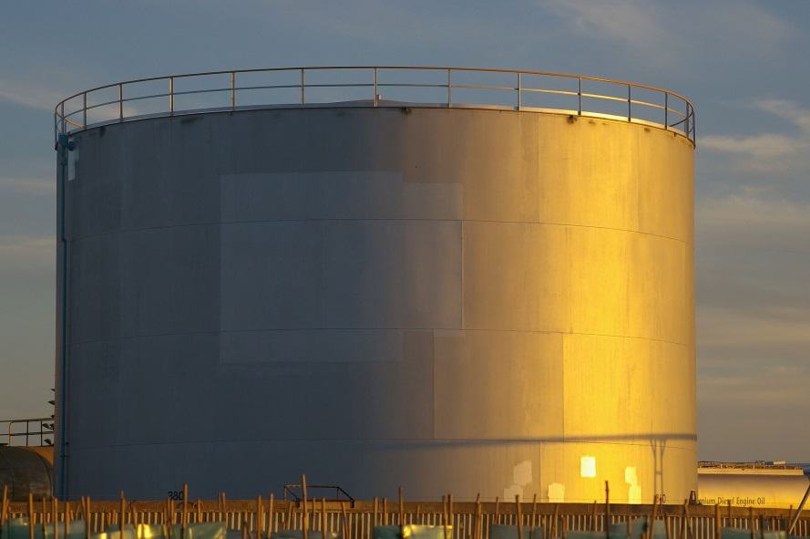
SYSTEM VALUATION
Erda Acres Water Company
2018 Annual Meeting
SOURCE
  Nelson Well – 700 gpm
  Campbell Well – 475 gpm
DISTRIBUTION
  13.75 Miles of pipe, 6” to 16” in diameter
STORAGE
  1 MG buried concrete reservoir
WATER RIGHTS
  1.5 acre-feet per acre dedication
  440 acre-feet total?
OPERATION EQUIPMENT
  Land, generator, buildings, SCADA system, booster pumps, etc.

Slide 9

SYSTEM VALUATION
Erda Acres Water Company
2018 Annual Meeting
SOURCE
DISTRIBUTION
STORAGE
  1 MG Capacity
  744,667 gal in 2017
  Market Value: $1,997,040.00
  Depreciated Value (2% /year): $1,605,620.00
  Depreciated Value of Excess Capacity: $409,968.31
WATER RIGHTS
  440 acre-feet total?
  236 acre-feet proofed
  Market Value ($10k / ac-ft): $4,565,000.00
  Market Value of Excess Rights: $2,116,500.00
OPERATION EQUIPMENT
Total $2,526,468.31
Grand Total $3,000,000.00

Slide 10

Erda Acres Water Company
2018 Annual Meeting
Loan Schedule
Year Principal Loan balance
2010 $21,000 $1,599,000 Loan Amount is $2,120,000, of which $1,620,000 is the Loan Proceeds and
2011 $22,000 $1,577,000 $500,000 shall be Principal Forgiveness if payments are made on time.
2012 $24,000 $1,553,000
2013 $26,000 $1,527,000 Total of 30 year payment schedule $1,620,000
2014 $27,000 $1,500,000
2015 $29,000 $1,471,000 Balance as of 9/30/2018 was $1,071,000
2016 $30,000 $1,441,000
2017 $33,000 $1,408,000 Balance as of 10/10/2018 was $1,002,000
2018 $36,000 $1,372,000
2019 $39,000 $1,333,000
2020 $42,000 $1,291,000
2021 $45,000 $1,246,000
2022 $48,000 $1,198,000
2023 $51,000 $1,147,000
2024 $54,000 $1,093,000
2025 $57,000 $1,036,000
2026 $59,000 $977,000
2027 $61,000 $916,000
2028 $63,000 $853,000
2029 $65,000 $788,000
2030 $67,000 $721,000
2031 $70,000 $651,000
2032 $72,000 $579,000
2033 $75,000 $504,000
2034 $77,000 $427,000
2035 $79,000 $348,000
2036 $82,000 $266,000
2037 $85,000 $181,000
2038 $88,000 $93,000
2039 $93,000 $-
Total $1,620,000

Slide 11

Erda Acres Water Company
2018 Annual Meeting
Water rate increase proposal.
The Board is recommending a water rate increase to occur during fiscal year 2018-2019.
  EAWC has not increased rates since the completion of the new system in 2009.
  The stability of our water rates is due to the increased number of connections.
  Growth in Erda has slowed.
    Sewer requirements imposed by Tooele County
    Encroachment from Stansbury Park Improvement district
    SPID proposed to Tooele county that any home that hooks up to their sewer is required to use their water.
    Competition from new water company
  Current water rates:
    $40.00 monthly base fee
    $0.75 for each 1,000 gallons of water used up to 70,000 gallons
    $1.25 for each 1,000 gallons of water used over 70,000 gallons
  Proposed water rate structure:
    $45.00 monthly base fee
    $0.75 for each 1,000 gallons of water used up to 70,000 gallons
    $1.25 for each 1,000 gallons of water used up to 140,000 gallons
    $1.75 for each 1,000 gallons of water used up over 140,000 gallons
  No increase if Pass Canyon Pipeline Company agrees to purchase.

Slide 12
Erda Acres Water Company
2018 Annual Meeting
Budget example supporting rate increase
FY 2019 Budget
Income $232,380
  Base $134,400
  Contract fee $24,000
  Hook Up Fee $4,000
  Late fees $3,000
  Water Service $65,000
  Reimburse $3,000
  Interest $580

Slide 13
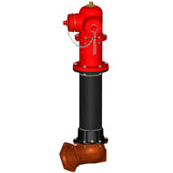

Erda Acres Water Company
2018 Annual Meeting
Shareholder Classifications
76 A class shareholders (original property owners)
154 B class shareholders (Properties 1 Acre or larger that joined after 10/1/2006)
C class shareholders (1/2 acre properties that joined after 10/1/2006)
1 D class shareholder with 4 shares (non-residential properties)
    Class B and Class C shares are convertible to Class A1 or Class A2
    Class D shares are not convertible to any Class A shares
    Shares in the Erda Acres are linked to property

Slide 14

Erda Acres Water Company
2018 Annual Meeting
Pass Canyon Pipeline Purchase Offer
Developer Joe White made an initial offer of $1,800,000.
Negotiations ensued for several months.
Erda Acres and Pass Canyon have come to a verbal agreement of $3,000,000.

Slide 15

Erda Acres Water Company
2018 Annual Meeting
Pass Canyon Pipeline Purchase offer
Erda Acres By-Laws
Proceeds from sale of assets will be distributed amongst Class A shareholders.
Class B and Class C shares can convert to Class A1 and Class A2 after 10 years.
Longest tenured Class B or Class C is dated 8/4/2009.
Sale of substantially all of the Company assets requires a shareholder Quorum.
Quorum will consist of 50% of the outstanding stock of the company.
50% requirement can be in person or by proxy.
Problem with By-Laws
If sale proceeds are distributed in accordance to existing By-Laws Erda Acres will lose is tax exempt status for this transaction.
Result - Erda Acres would be subject to a corporate tax (approximately 20%).
Shareholders will also be taxed on a personal level.

Slide 16



Erda Acres Water Company
2018 Annual Meeting
Pass Canyon Pipeline Purchase offer
Solution to Erda Acres By-Laws
Change By-Laws to allow equal distribution of sale proceeds to all shareholders.

Slide 17
Erda Acres Water Company
2018 Annual Meeting
Pass Canyon Pipeline Purchase Offer
Shareholder distribution example (figures from Oct 2018 statement)
  Sale Price $3,000,000
  State Loan Balance $1,002,000
  Sale Proceeds $1,998,000
  Bank Accounts $503,310
  Gross Distributions $2,501,310
  Accounts Receivable $23,000
  Estimated Projects $50,000
  Estimated Transaction Costs $100,000
  Net Distributions $2,328,310
  Distribution per Shareholder $8,345 ($2,328,310/279)

Slide 18

Erda Acres Water Company
2018 Annual Meeting
Pass Canyon Pipeline Purchase obstacles
Referendum
  Group of Erda residents is opposed to approved zoning change (1/2 acre lots).
  Has until December 7, 2018 to obtain 2,700 signatures.
  If 2,700 or more signatures are obtained by 12/7/2018 approved zoning changed is on hold.
  Tooele county has until 1/7/2018 to verify signatures.
  If 2,700 or more signatures are verified by Tooele county Referendum proceeds for a vote on the 2019 November ballot.
  If less than 2,700 signatures are obtained by 12/7/2017 approved zoning changes can proceed.
Stansbury Park Improvement District (SPID) proposal to Tooele County.
  SPID has approached Tooele County to require any property that hooks up to SPID sewer by required to use water provided by SPID.
  Tooele County now requires residential property smaller than 5 acres to be hooked up to a sewer line.

Slide 19

Erda Acres Water Company
2018 Annual Meeting
Board Member Directory
Tom Isom, President (expire odd)
435-843-9023 (H); tisom2000@yahoo.com
Rob Adams, Vice President (expire odd)
801-673-9092; wingmanut@gmail.com
Blanche Smith, Treasurer (expire even)
435-850-9106 (M); tiserdaacres@gmail.com
Michael Webb, Secretary (expire even)
385-252-1519 (M); webbmike3609@gmail.com
Brian Townley, 801-647-5207 (expire even)
BJTUSA@ME-MAN.com
Larry Brown 801-232-6905 (expire even)
lbrown@wheelercat.com
Elke Ewell, 435-850-8214 (expire even)
elkeewell@gmail.com
Michael Hartvigsen, 801-824-0053 (expire odd)
mdh4x4@gmail.com
Dave Gunderson, 605-430-2291 (expire odd)
obie58@yahoo.com

